Slide 1


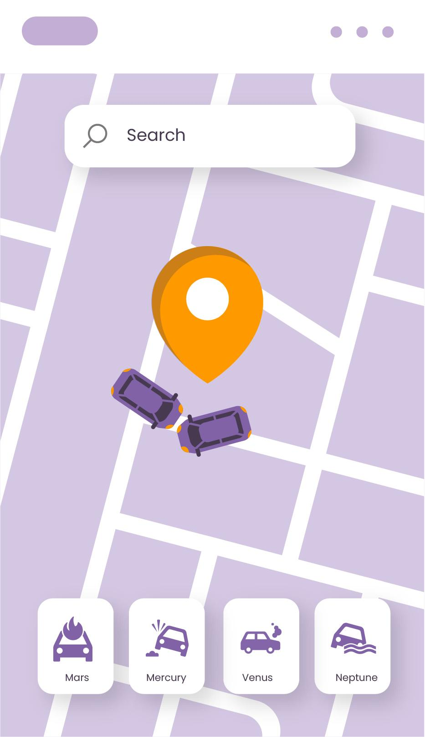
Traffic for lane Monitoring
YOLOv8 - Project
REPORT!
Team Members:
Sama Al-harbi
Rahab Al-mahdawi
Raghad Al-moqhim
5-9-2024

Slide 2
Table of contents
01
02
03
04
05
06
Introduction
Dataset
EDA
Methodology
Results
Conclusion

Slide 3

Introduction
Our project is about computer vision using yolov8

Slide 4

Dataset
Traffic CCTV Footages for Lane Monitoring
60%
Validation
20%
Train
Test
20%

Slide 5
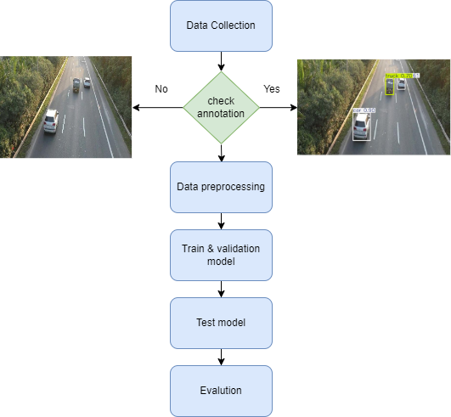
Methodology

Slide 6
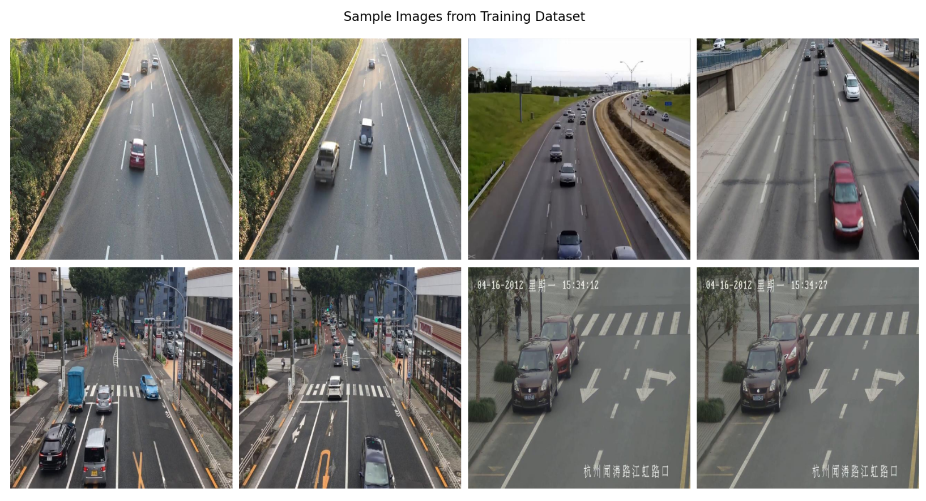
Exploratory Data Analysis
Sample data from training dataset
Classes :
- IN LANE
- OUT OF LANE

Slide 7
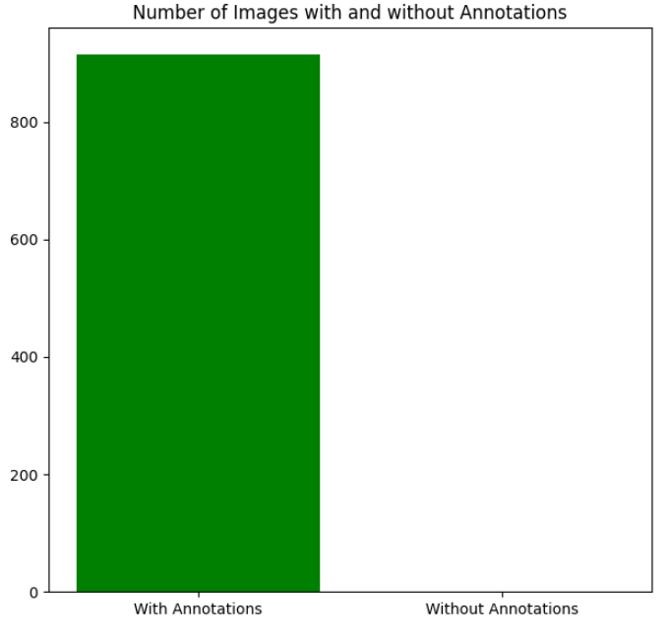

Exploratory Data Analysis
Annotation Images

Slide 8
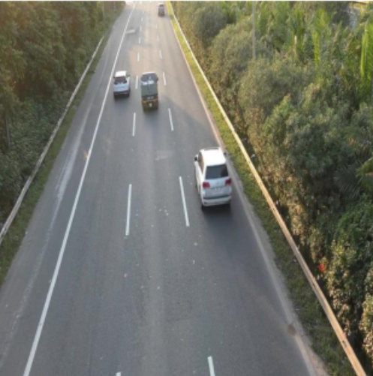
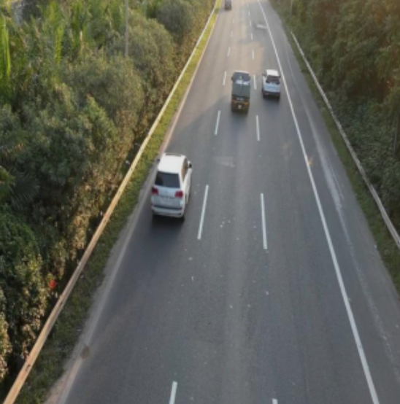



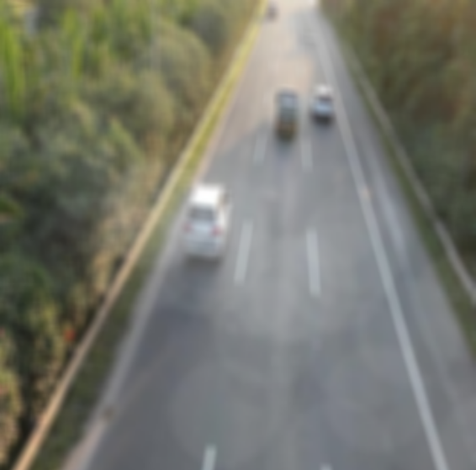
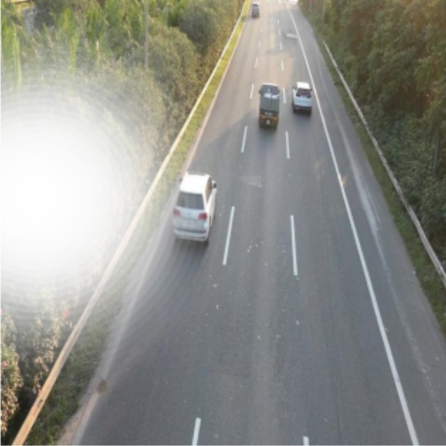

Data Augmentation
Brightness & Contrast
Horizontal Flip
Sun Flare
Fog

Slide 9
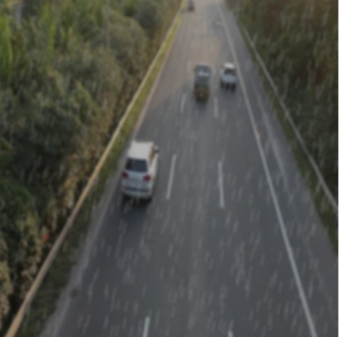
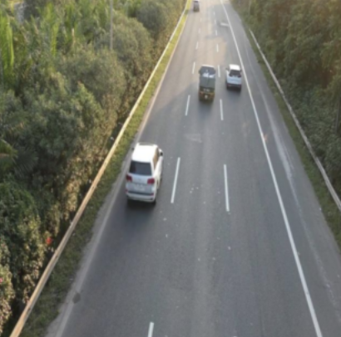
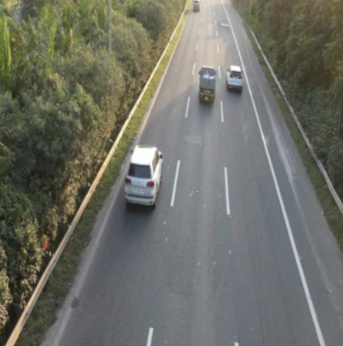
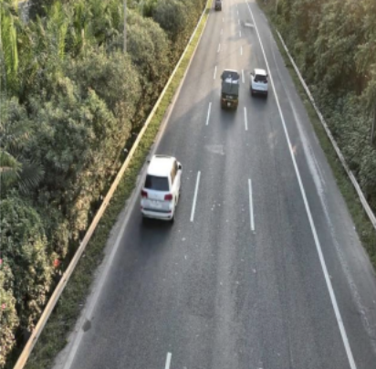
Data Augmentation
Rain
Gaussian Blur
Scale
CLAHE

Slide 10
Builds Models
Yolov8n
Yolov8s
Yolov8m

Slide 11
Results
Table 1. The comparison of the base model and other parameters
Model | Precision | Recall | mAP50
Modelv8n | 0.83 | 0.82 | 0.86
Modelv8s | 0.91 | 0.92 | 0.94
Modelv8m | 0.9 | 0.93 | 0.95

Slide 12
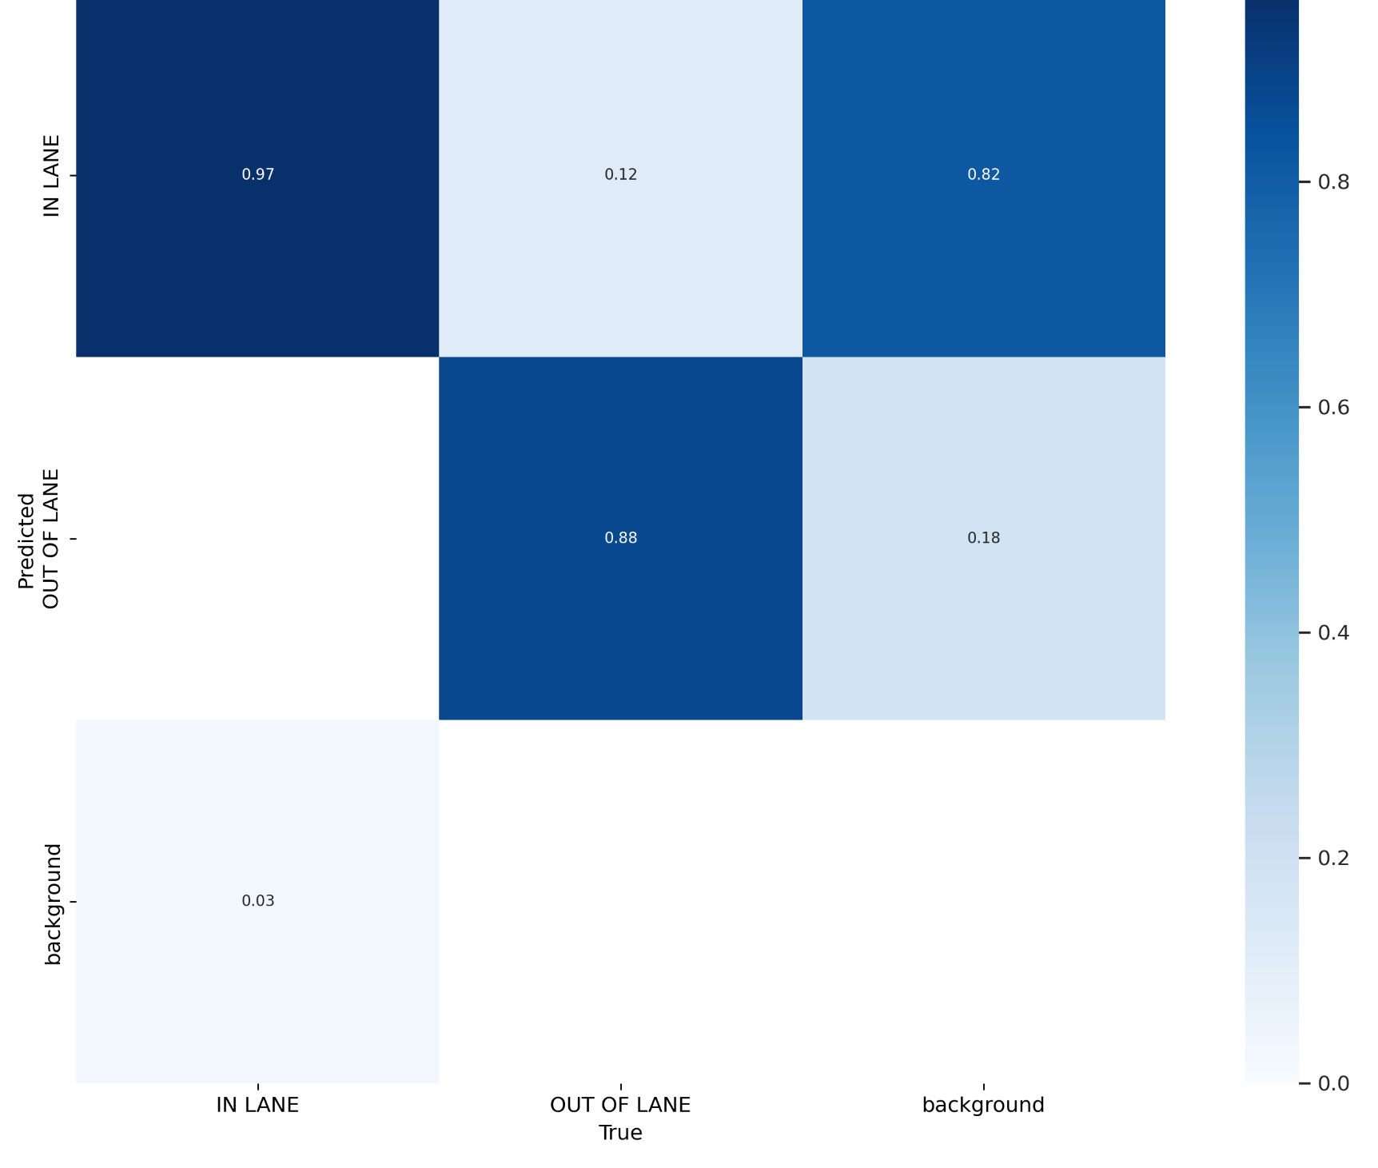
Results
Modelv8m Confusion Matrix

Slide 13
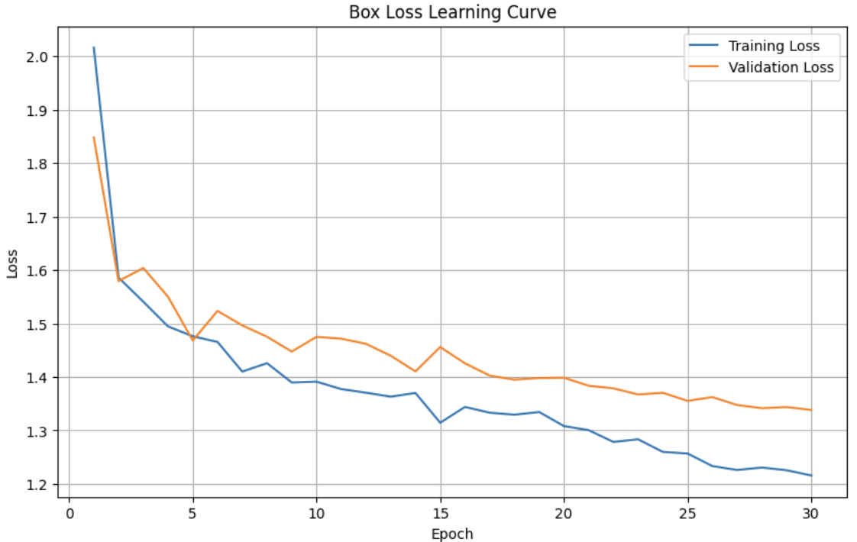
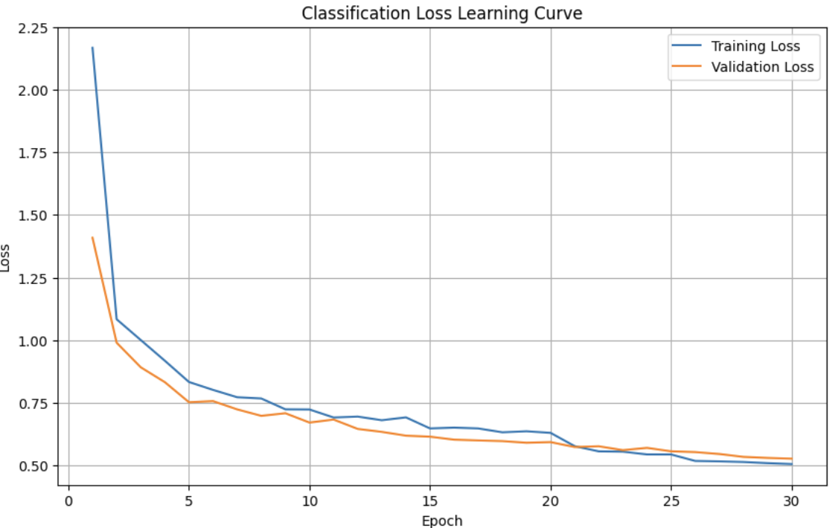
Results

Slide 14
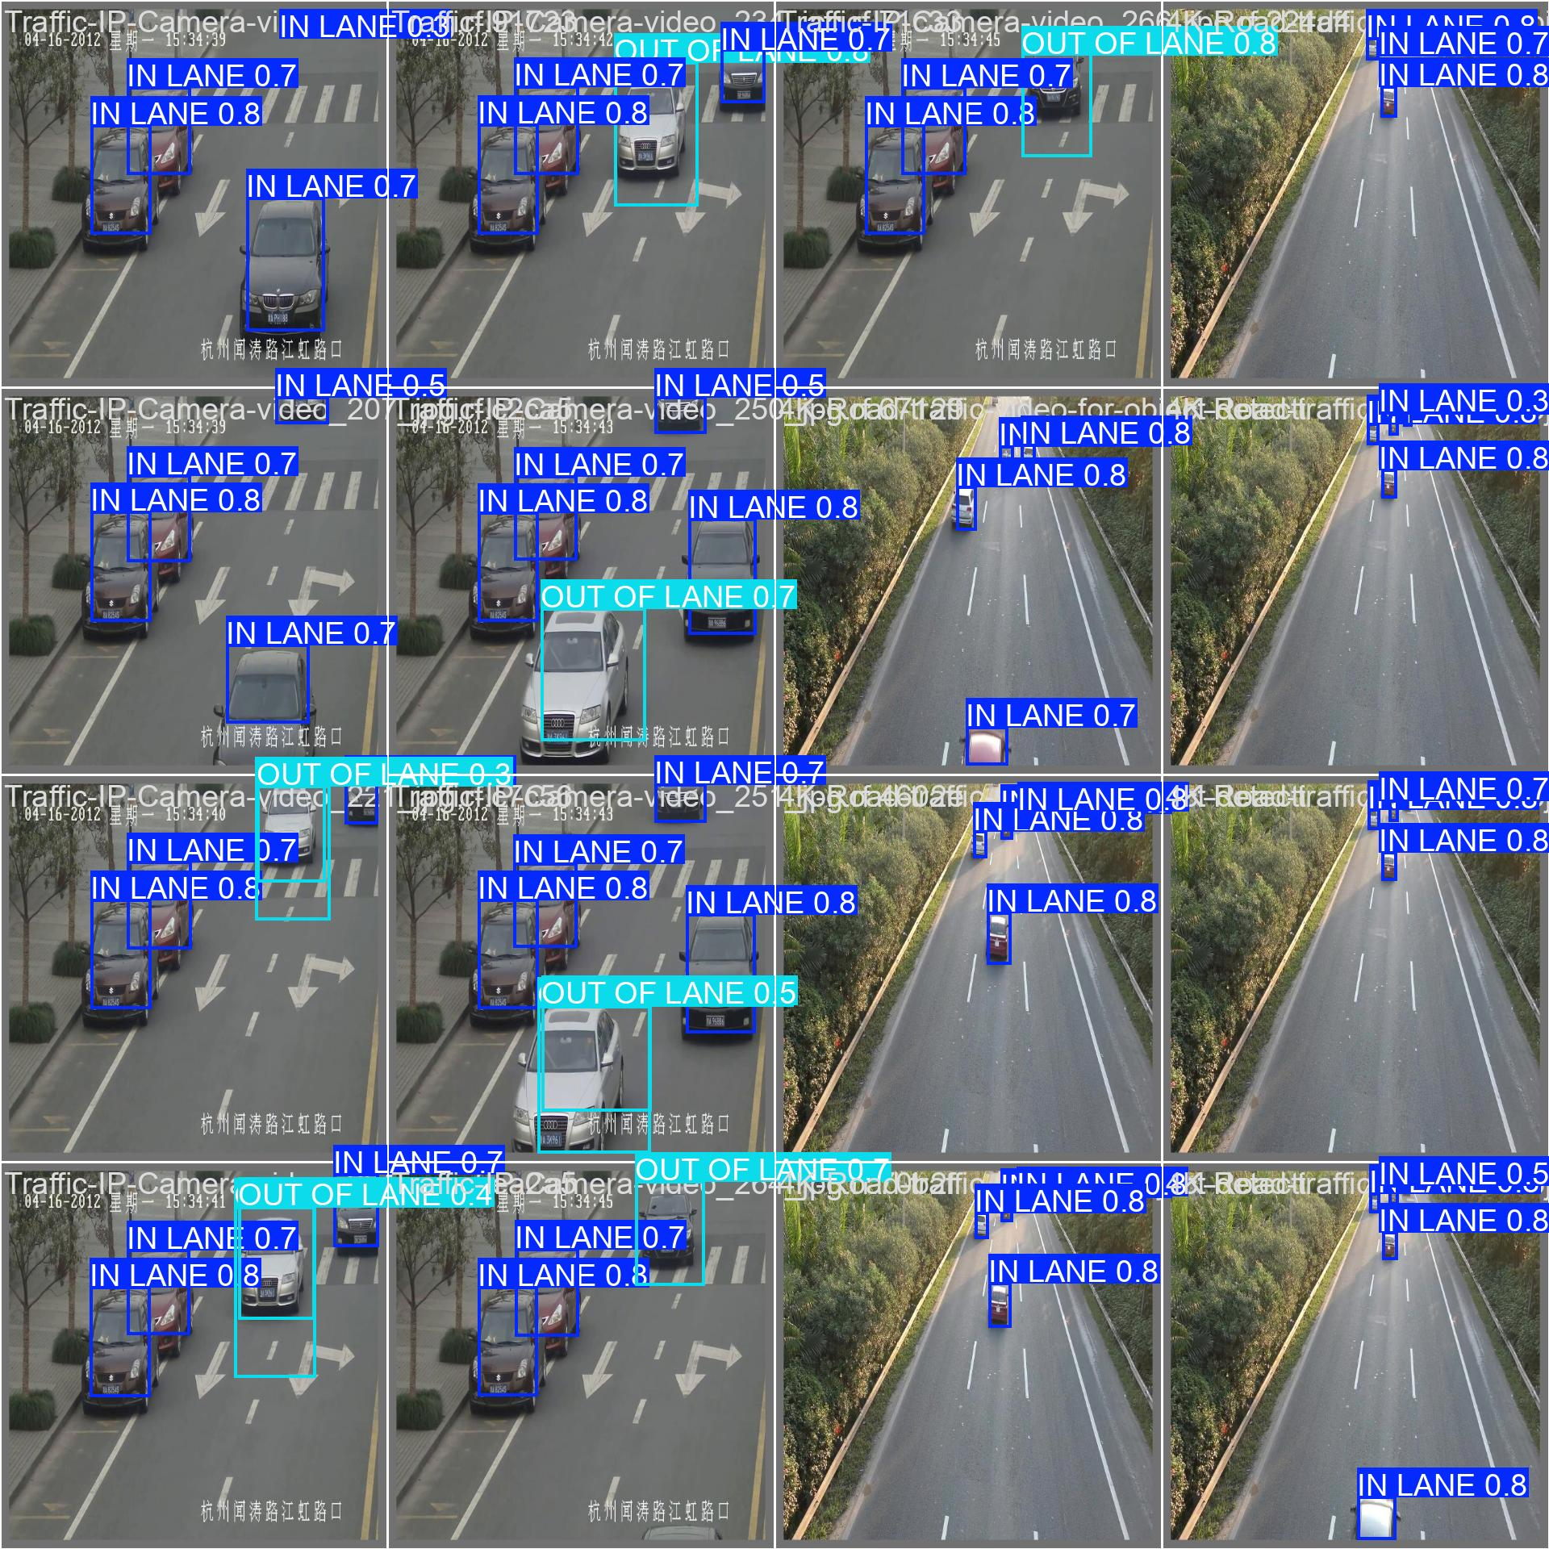
Results
Modelv8m predict
val-batch0-pred

Slide 15
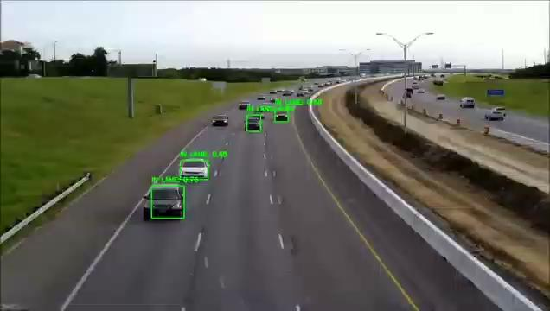
Test Model

Slide 16
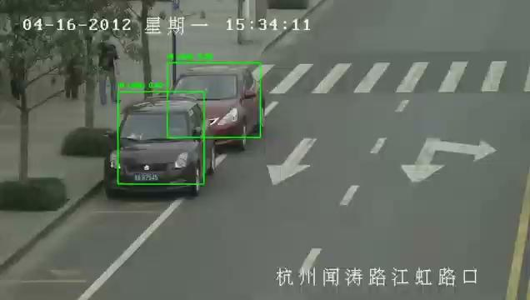
Test Model

Slide 17
Conclusion
Key Insights:
1- Best Overall Model Performance
2- Model's Effectiveness in Car Classification

Slide 18
Team Collaboration & Contribution
Sama | Builds modelv8m
Rahab | Builds modelv8n
Raghad | Builds modelv8s

Slide 19
THANKS
Do you have any questions?

